Slide 1
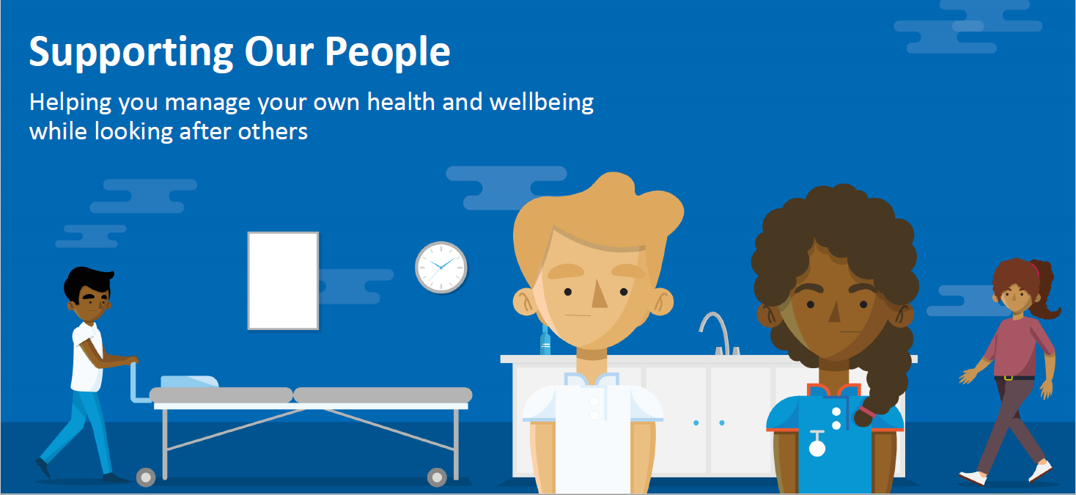
NHS Staff Wellbeing Support
A whole range of wellbeing support offers are available from the NHS People website for colleagues across all care sectors including Primary and Social care through helplines, online Apps and coaching.
Please continue to share and promote within your organisations/teams so that colleagues can access the support if they need it
To access these support offers please go to
https://people.nhs.uk/

Slide 2
https://people.nhs.uk/

Slide 3
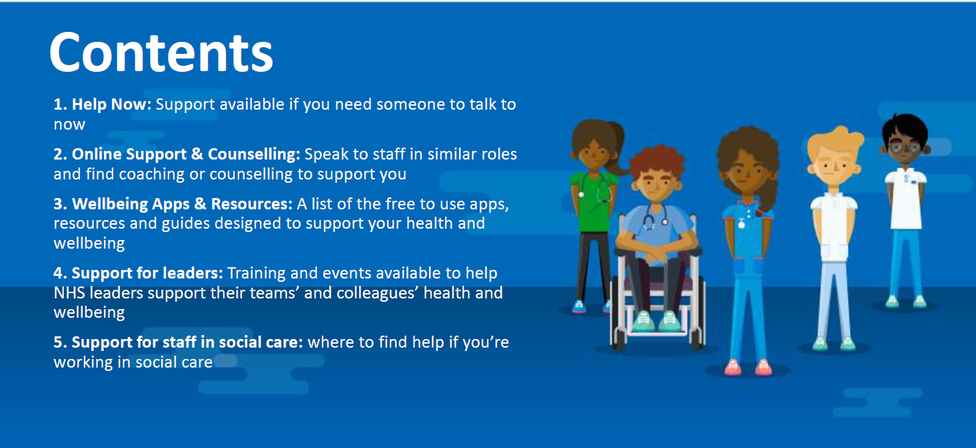

Slide 4
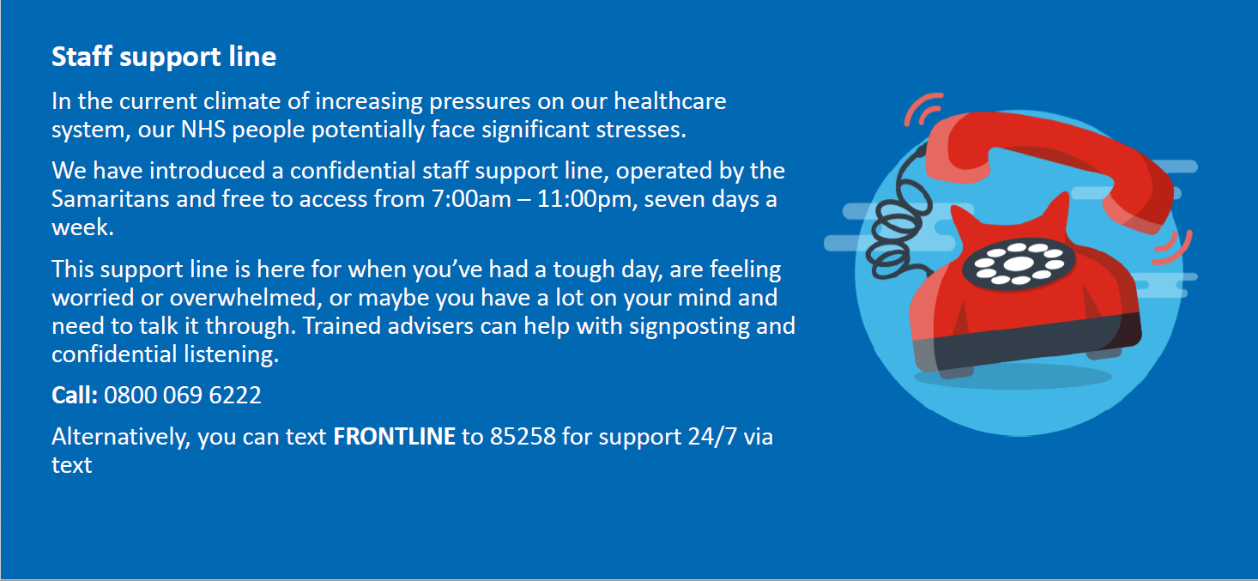
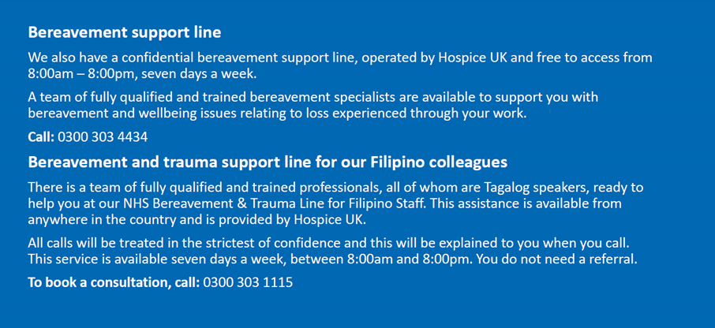
1. Help Now
To access these support offers please go to
https://people.nhs.uk/

Slide 5
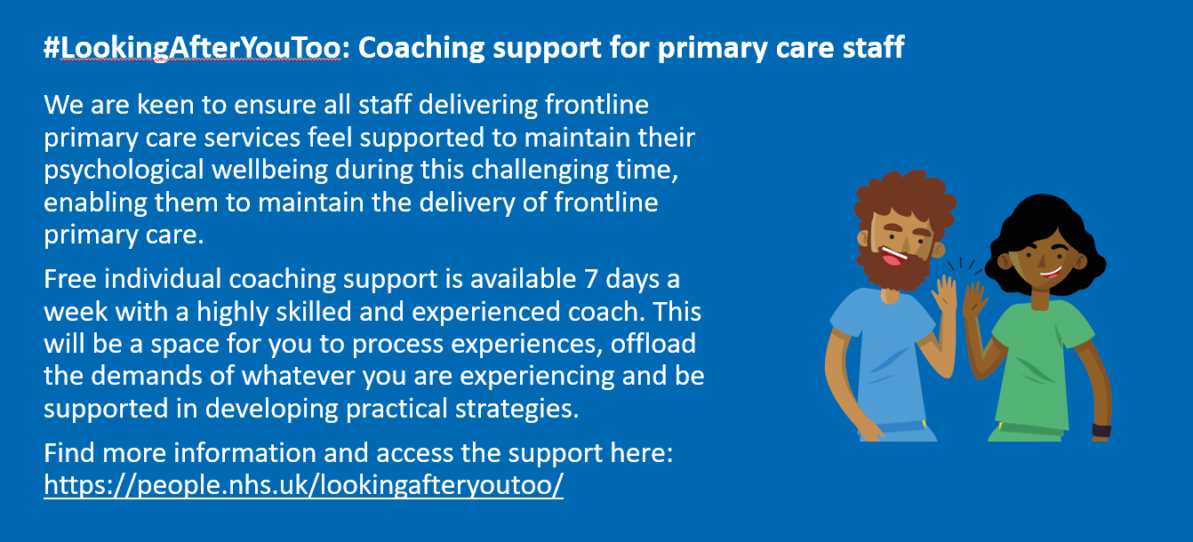
2. Online Support & Counselling
To access these support offers please go to
https://people.nhs.uk/

Slide 6
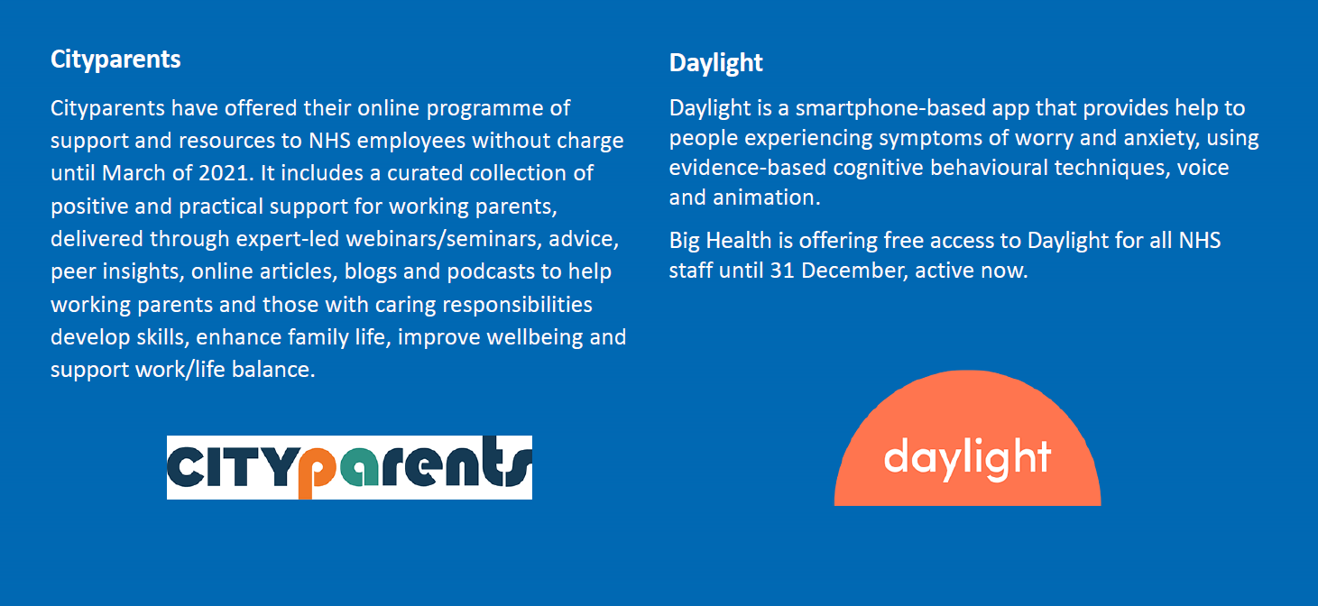
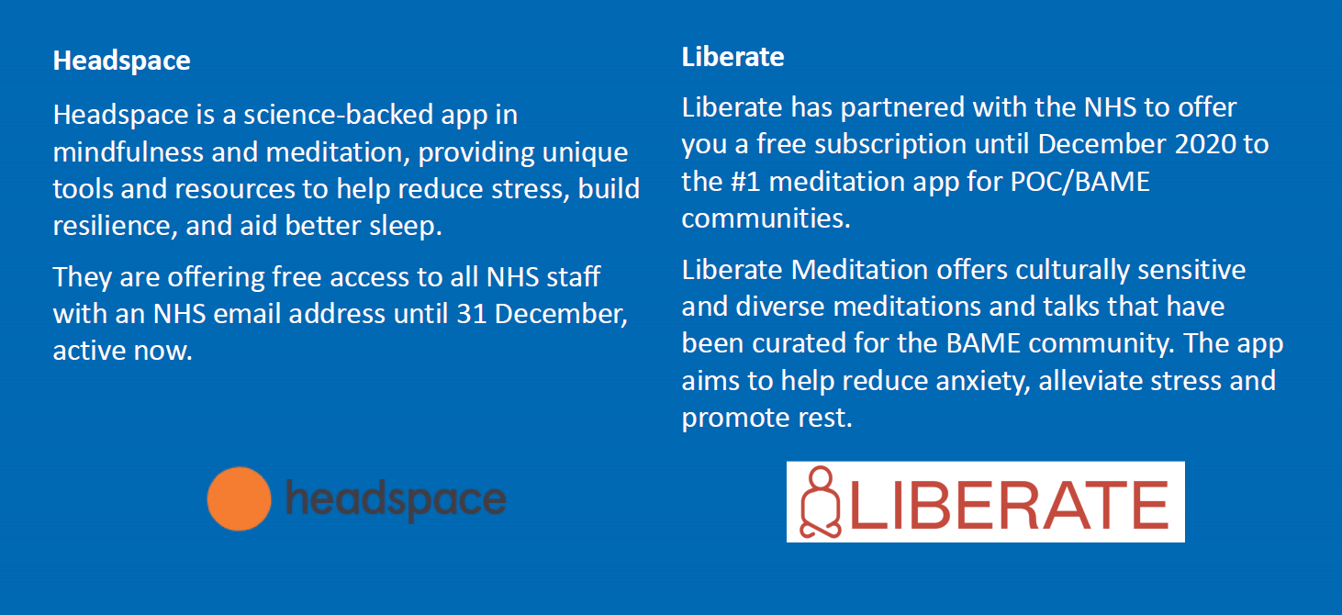
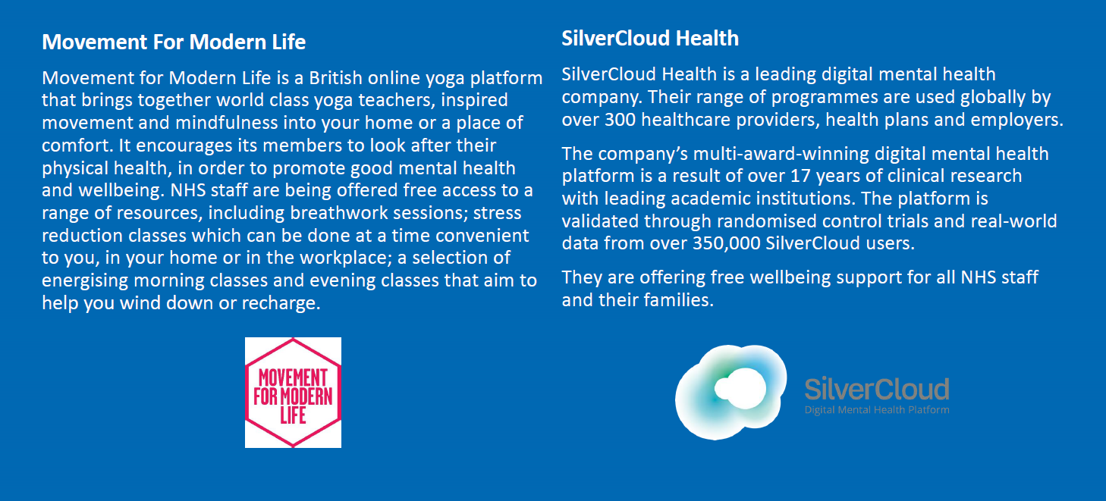
3. Wellbeing Apps & Resources
To access these support offers please go to
https://people.nhs.uk/

Slide 7
3. Wellbeing Apps & Resources
To access these support offers please go to
https://people.nhs.uk/

